Slide 1
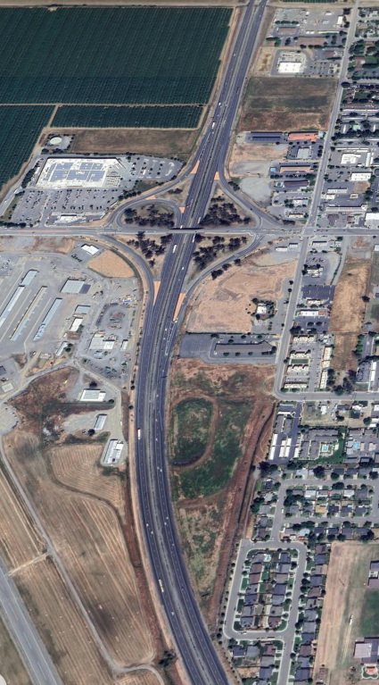
I-5 Feasibility Study
May 28, 2024
Notes:
General description about collecting fees to cover the cost of services

Slide 2
The sites reviewed include properties in the cities of :
Willows
Orland
Corning
Glenn County
Jurisdictions
Notes:
General description of each

Slide 3
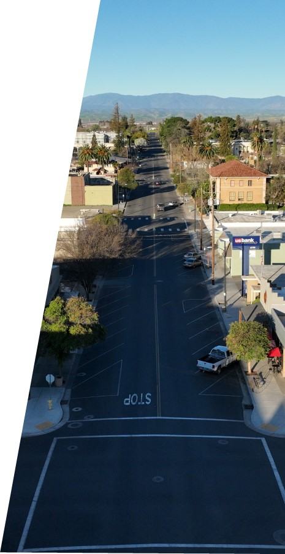
The study objective is to pinpoint specific sites and geographic areas for future economic development.
Study Purpose
Notes:
General description of each

Slide 4
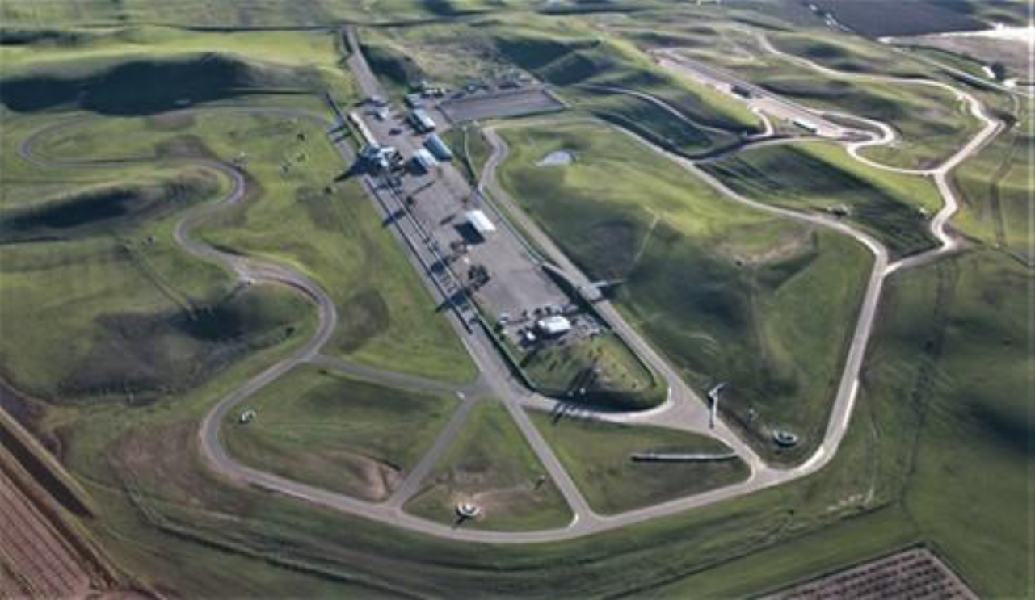
Strengths:
Location
Market Depletion
Near Term Sites
Rail Access
Thunderhill Raceway Park

Slide 5
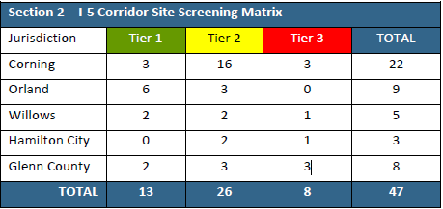
weaknesses
1. Market Ready Properties
2. Resource Capacity
3. Brand and Marketing

Slide 6
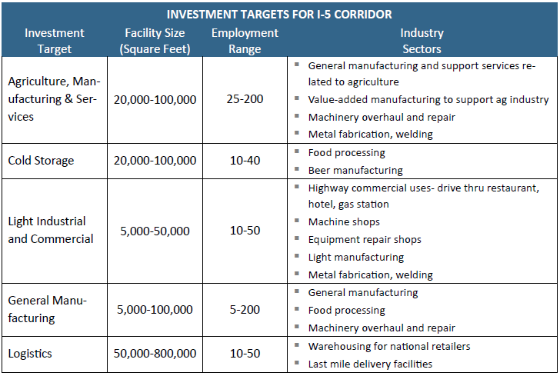
Opportunities:
1. Corridor Region
2. Brand Marketing
3. Existing Sites
4. Business Investment Targets
5. Emerging Market Sectors

Slide 7
threats:
1. Rural Setting
2. Infrastructure to Support Growth
3. Housing

Slide 8
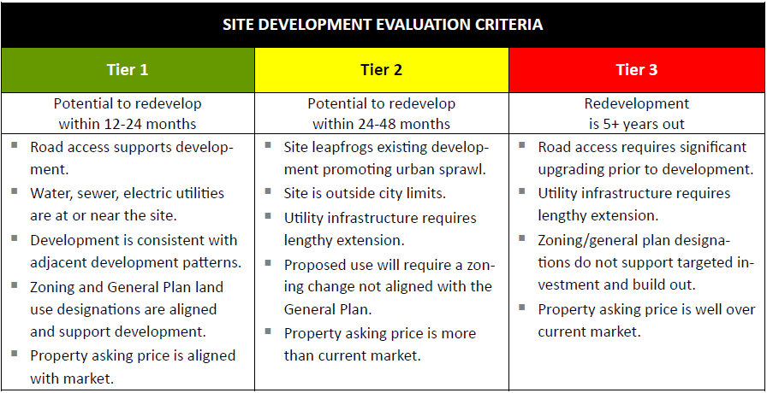
Site Analysis
Notes:
Describe the elements of the water heater that are required and inspected

Slide 9
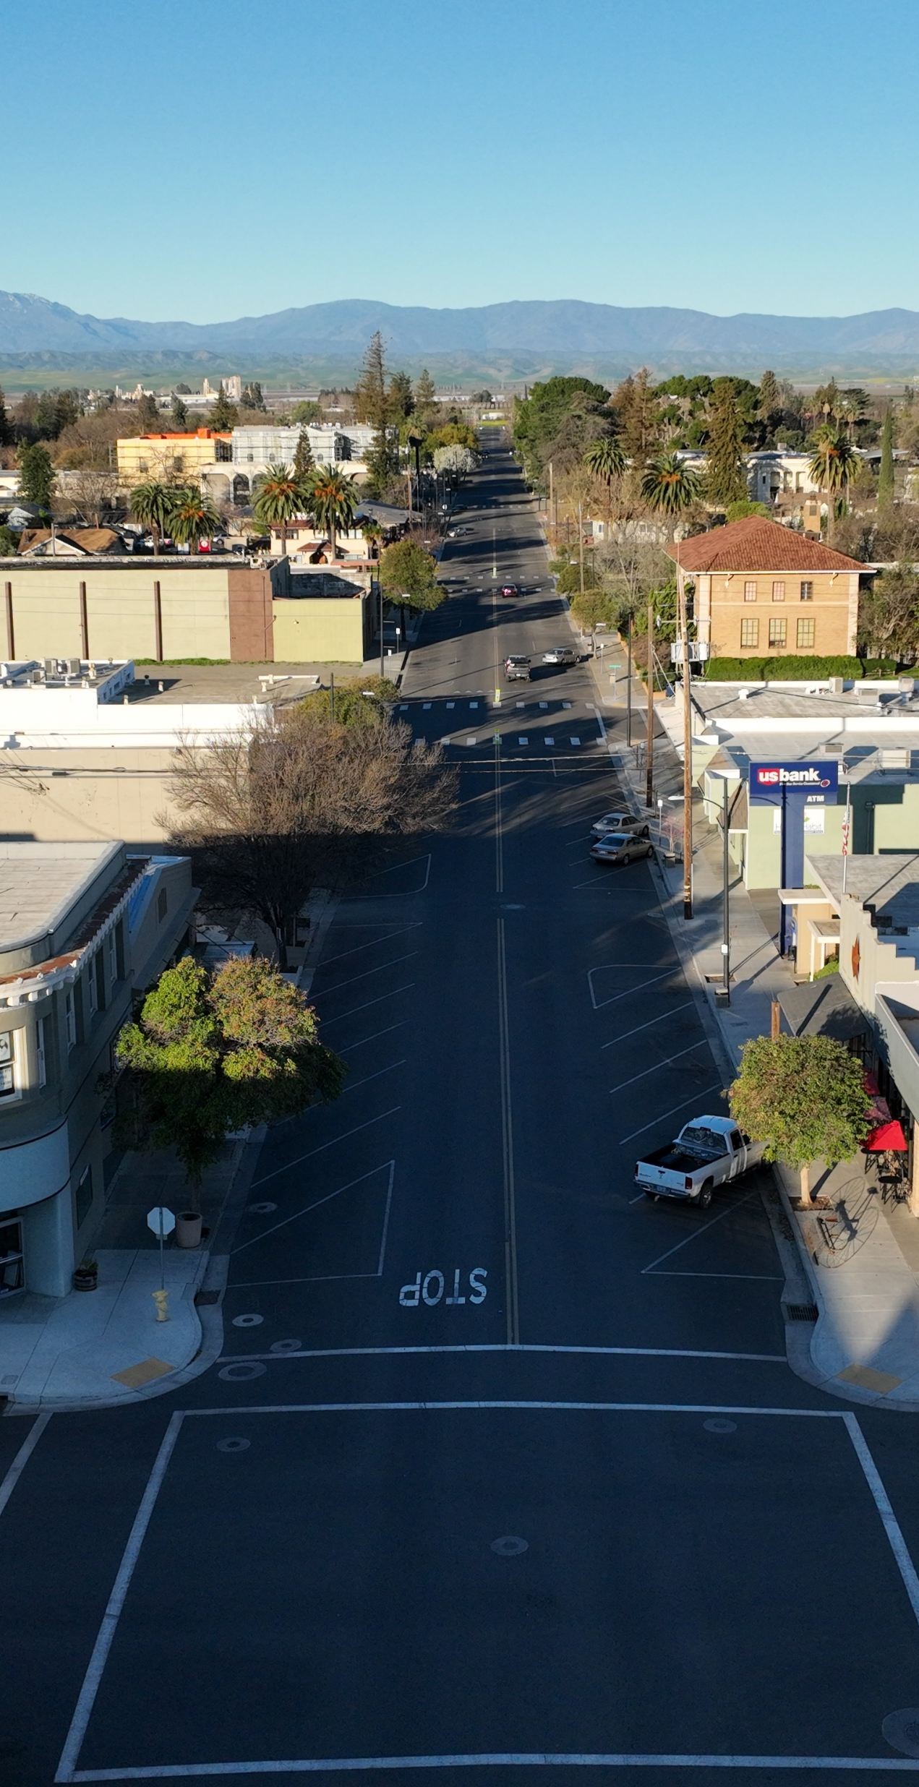
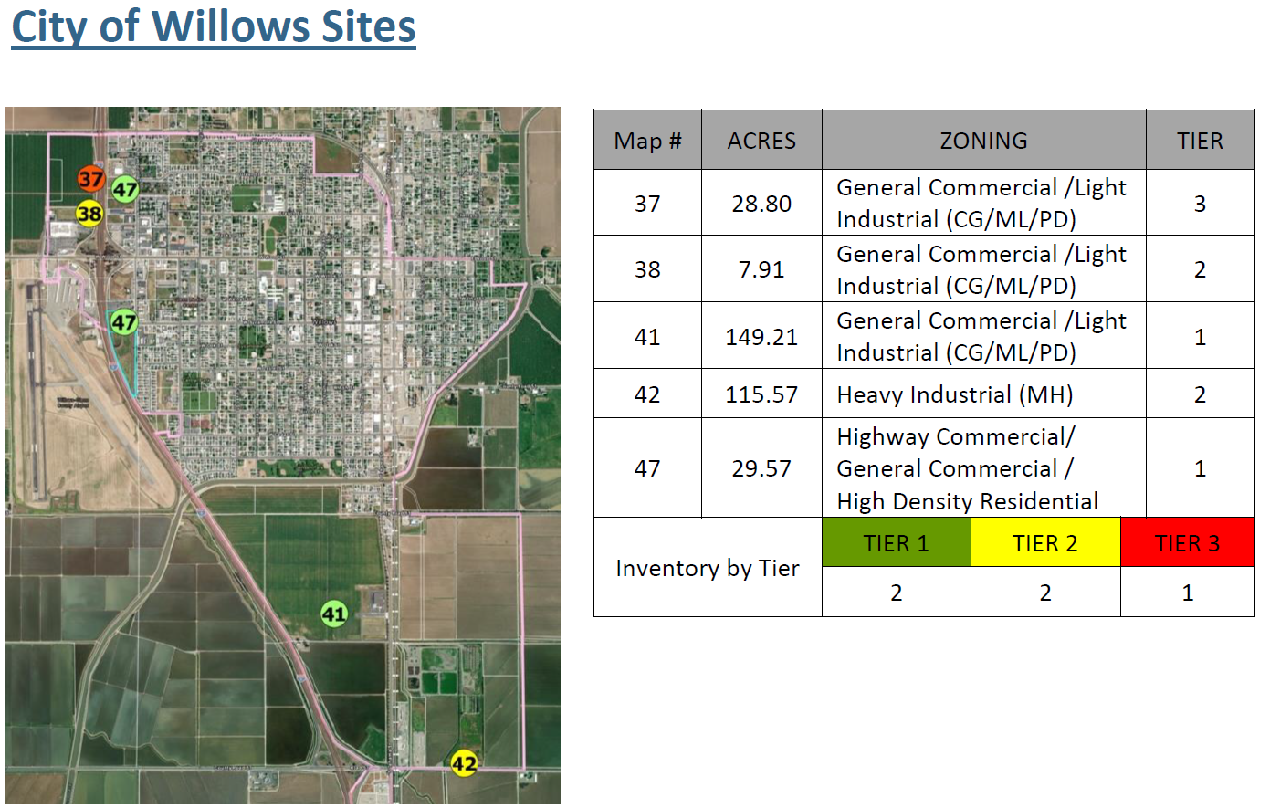
Site Analysis

Slide 10
Investment targets- Tier 1
North Valley Commercial Center-
Cold Storage
Light Industrial, Commercial
General Manufacturing
Logistics
N. Humboldt Ave.-
Light Industrial, Commercial

Slide 11
Actions
North Valley Commercial Center
▪ Master planned center is being actively marketed by Basin Street Properties. The only existing tenant is Rumiano Cheese.
▪ Connect with national cold storage brokers/developers. Potential to support local food producers.
▪ Discuss if there is opportunity/potential for City to build spec light industrial/warehouse. Meet with local and regional light industrial developers to promote site for spec industrial Development.
North Humboldt Ave
▪ South parcel is zoned CH, northern 2 are CG. Determine if re-zone is needed to accommodate proposed development.

Slide 12

Questions?

