Slide 1

City of Willows Banner Program
November 15, 2023 meeting of the Planning Commission

Slide 2
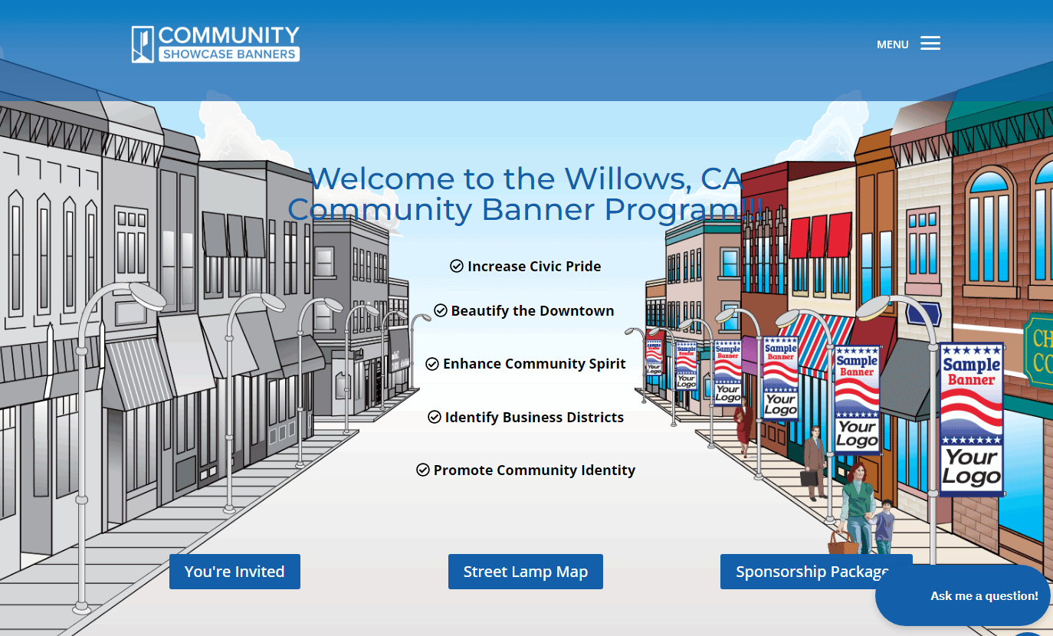

Slide 3
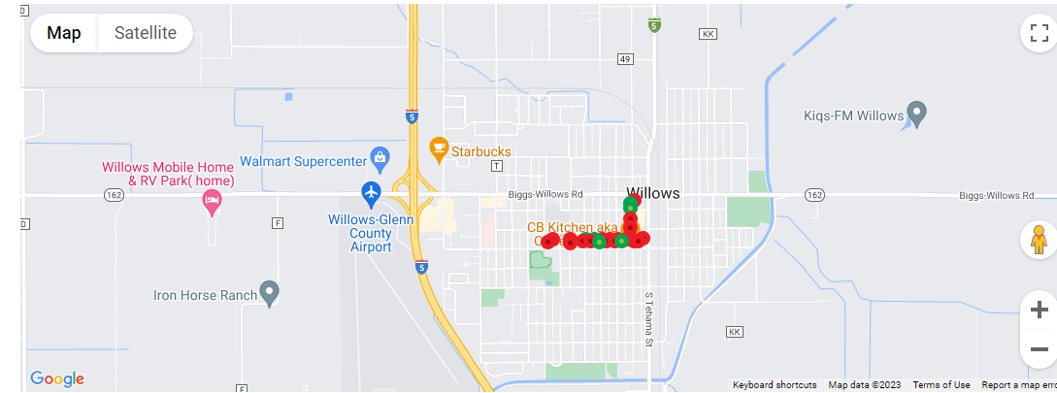
City of Willows Banner Program
November 15, 2023 meeting of the Planning Commission

Slide 4

City of Willows Banner Program
November 15, 2023 meeting of the Planning Commission

Slide 5

City of Willows Banner Program
November 15, 2023 meeting of the Planning Commission

Slide 6

City of Willows Banner Program
November 15, 2023 meeting of the Planning Commission

Slide 7

City of Willows Banner Program
November 15, 2023 meeting of the Planning Commission

Slide 8

City of Willows Banner Program
November 15, 2023 meeting of the Planning Commission

Slide 9
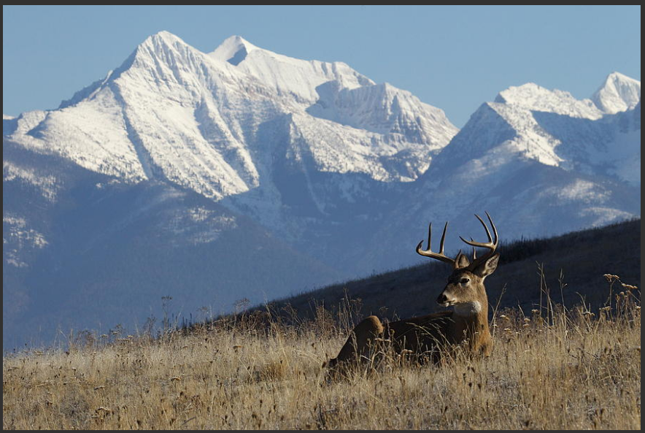

Suggested Alternatives

Slide 10

Suggested Alternatives

Slide 11

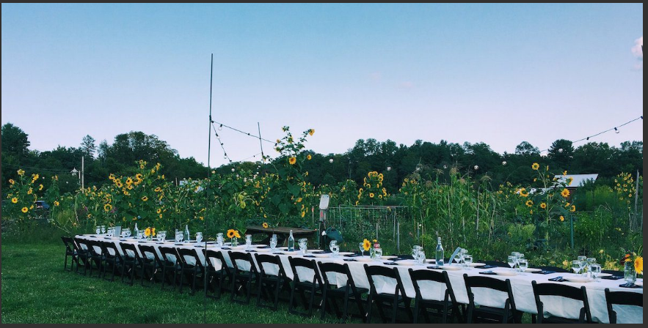
Suggested Alternatives

Slide 12
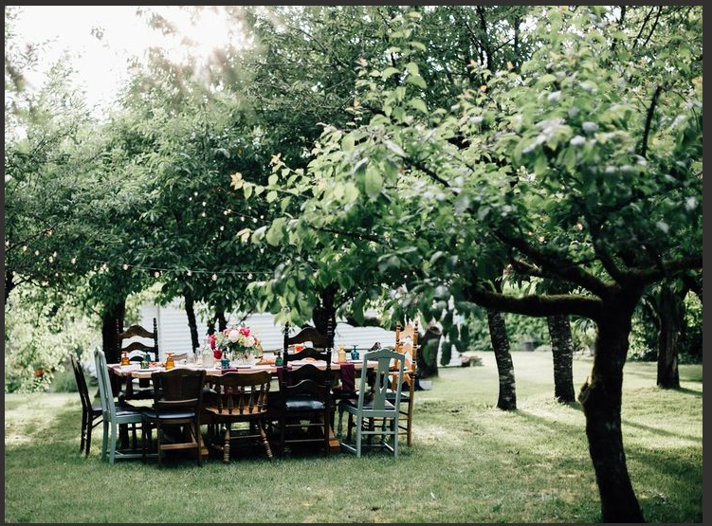
Suggested Alternatives

