Slide 1

Master Fee Schedule, Impact fees, and cost recovery process:
Why do Cities charge fees?
Council Study Session | July 25, 2023
Notes:
General description about collecting fees to cover the cost of services

Slide 2
Permit Fees (Master Fee Schedule):
Include planning application fees, building permits, building inspection, encroachment permits, engineering plan check – these are one-time fees.
Development Impact Fees (DIF):
A one-time fee to off-set the impact of new development on the city’s physical (e.g., sewage, storm drain, transportation, etc.) and civic (e.g., police, fire) infrastructure.
Cost Recovery:
A deposit to the City for which consultants who work on said project charge their time against to recover the cost of processing a development application. The City does not earn a profit. It is intended to break even on the cost of processing a development application and ensure that taxpayer dollars are not being used to subsidize private projects.
Fee Types
Notes:
General description of each

Slide 3
Master Fee Schedule – Permit Fees

Slide 4
Permit fees
Fees are collected in order to cover the cost of delivering services and application review.
Cost recovery charges are only used to cover the cost of consultant time to process a development application.
The city cannot earn a profit from the permit fee process and development application review.

Slide 5
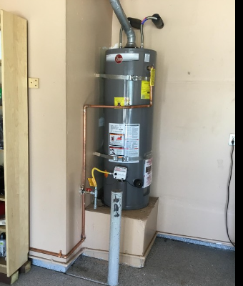
Why is a permit needed?
Notes:
Describe the elements of the water heater that are required and inspected

Slide 6
low fees in willows
Example: HVAC Permit Cost Comparison
Colusa Orland Willows
$185 $184 $77.60

Slide 7
low fees in willows
Example: New Garage Permit Comparison
New Garage 20’ x 24’
Colusa: $696 plus 3% of the project valuation for a General Plan Fee
Orland: $734 plus 2.5% of the project valuation for General Plan Fee
Willows: $471.15

Slide 8
Development Impact Fees (DIF)

Slide 9
Development Impact fees (DIF)
Mitigation Fee Act – AB 1600
Allows the collection of fees to fully or partially offset the cost of future public capital facilities and infrastructure that is needed to serve new demand created by development projects.

Slide 10
DIF Benefits
Ensures that impacts of new development are paid for by the developers and new members of the population.
Used to fund new or expanded facilities to service the needs of a growing population.

Slide 11
Dif Restrictions
Fees are collected for public facility improvements only.
Fees can only fund public facilities or infrastructure needed as a result of
new development.
Fees cannot be used for maintenance, to repair existing facility or infrastructure deficiencies.

Slide 12
Dif Restrictions (cont.)
Use of fees must be based on a rational nexus between new development and the costs of new facilities to accommodate a growing population.
The nexus study identifies activities that the DIF can be used for and meet the requirements established by AB 1600.

Slide 13
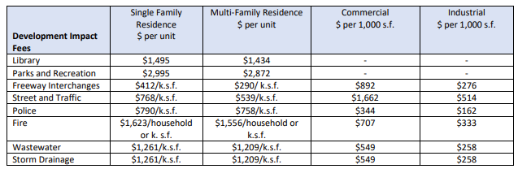
Current Impact Fees
Current Impact Fees

Slide 14
Library improvements
Current funds – $142,214
Projects identified in 2008 DIF Report where money can be spent:
An additional 3,063 square feet of library
27,032 new books
2.5 new computer workstations

Slide 15
Parks and Recreation improvements
Current funds - $334,783
Projects identified in 2008 DIF Report where money can be spent:
Solar lights for park around play equipment/pathways and pedestrian walkway lighting
2 new softball fields
Bike paths/BMX course
Warm-up areas for softball pitchers
Coin/token operated softball lights
Pathways in parks
Trees
2 soccer fields
14 acres of additional parks

Slide 16
Freeway Interchange improvements
Current Funds - $390,369
Projects identified in 2008 DIF Report where money can be spent:
Improvements to the Road 57/I-5 interchange to accommodate expansion to South Willows.

Slide 17
Street and traffic improvements
Current Funds - $182,814
Projects identified in 2008 DIF Report where money can be spent:
Tehama @ Sycamore Streets – Right Lane & Signal Modification
Tehama Street (Cedar Street to Road 53) – Widening to four lanes
Tehama Street @ GCID canal bridge modifications
Tehama Street (Northbound @ Road 53) – Right Turn Lane Improvements
Tehama Street @ Road 53 – Intersection Reconstruction
Road 53 westbound @ Tehama Street – Construct right turn lane
Sacramento Street @ GCID canal bridge modifications

Slide 18
police improvements
Current Funds - $61,068
Projects identified in 2008 DIF Report where money can be spent:
Costs related to the expansion of the Glenn County Sheriff’s Office’s that may be necessary to accommodate services associated with the City of Willows as the population increases.

Slide 19
Fire improvements
Current Funds - $66,144
Projects identified in 2008 DIF Report where money can be spent:
One new structure engine
Outfit new engine
Purchase three new breathing apparatus
Expand the existing fire station

Slide 20
Wastewater improvements
Current Funds - $1,784
Collected funds are committed to the annual payment of long-term debt incurred by the City for the expansion of the Wastewater Treatment Plant that occurred in 2005.

Slide 21
Storm Drainage improvements
Current Funds - $153,328
Projects identified in 2008 DIF Report where money can be spent:
Collected funds are committed to the annual payment of long-term debt incurred by the City for the expansion of the Wastewater Treatment Plant.

Slide 22
Cost Recovery Process

Slide 23
Cost Recovery
The cost to process development projects, permits and applications submitted by private individuals or commercial interests that are intended for private or for-profit use and do not provide a public and community benefit.

Slide 24
Based on CONSULTANT time
Use Permit
Design Review
Variance
Subdivision
Rezone
General Plan Amendment
Lot Merger or Adjustment
Environmental Review (CEQA)
Encroachment Permits
Engineering plan check
Map and legal description checking

Slide 25
Based on CONSULTANT time (cont.)
Reasons why costs are difficult to predict:
Full project is not yet determined,
Incomplete plans are submitted,
Applicant is unable to provide required plans,
Applicant is unable to provide corrections,
City Consultant spends considerable time communicating with applicant, and
City Consultant spends considerable time in meetings and/or preparing for meetings.

Slide 26
Improvements to cost recovery process
Developing new contract/agreement to better explain cost recovery process and fees to the applicant.
Establishing new more detailed description and checklist of services and activities providing greater accountability to applicant.
Notes:
Describe what changes staff is making to improve the process and customer understanding

Slide 27
Improvements to cost recovery process (cont.)
Developing standardized routing and workflow system to ensure internal accountability (e.g., City Planner, City Engineer, Finance).
CM will be “Cost Recovery Coordinator” until a new CD&S Director is hired.
Notes:
Describe what changes staff is making to improve the process and customer understanding

Slide 28
Discussion & Questions

