Slide 1
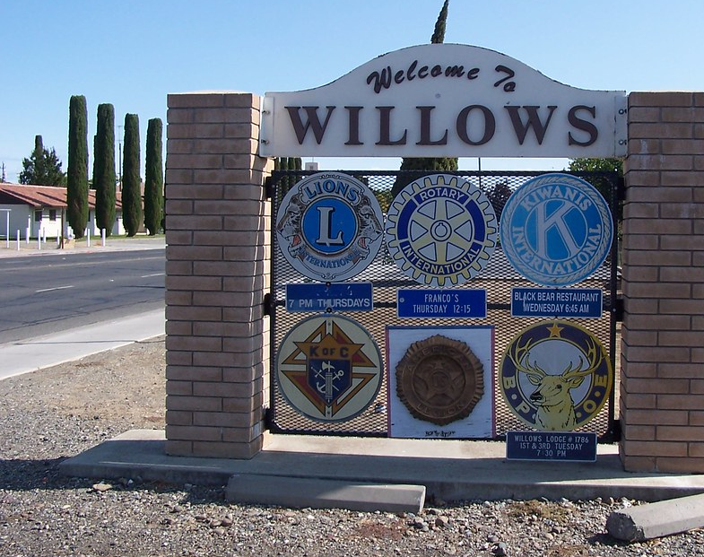
City of Willows Planning Commission
November 15, 2023

Slide 2
File #RZ-23-02; GPA-23-02
345 E. Laurel St.
Fleming

Slide 3
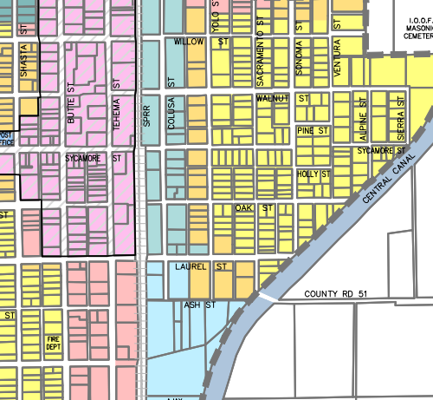
Location
345 Laurel St

Slide 4
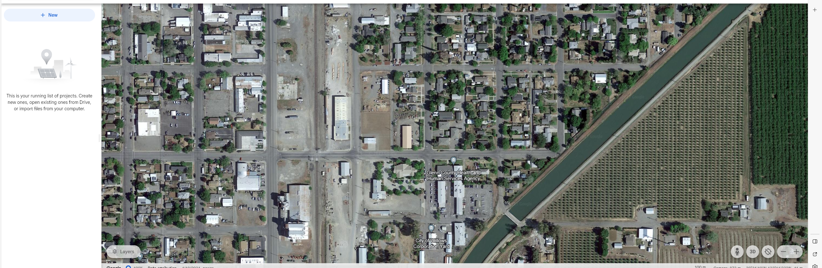

Source: Google Maps

Slide 5
Request
Change Zoning from Residential Professional to Light Industrial
Change General Plan Designation from Office Professional to Light Industrial
Requires Approval from the Planning Commission and a recommendation to the City Council

Slide 6
History
1,900 sq. ft. structure
Originally 2 parcels; structure improved with carport across property lines & across zoning & General Plan boundaries
2021 - parcels merged to correct violation
As part of the merger, zoning and General Plan changed to avoid 1 parcel with 2 designations
Changing to RP and Office Professional rendered the building non-conforming and less useable
Staff emails confirm denial of business licenses on-site

Slide 7
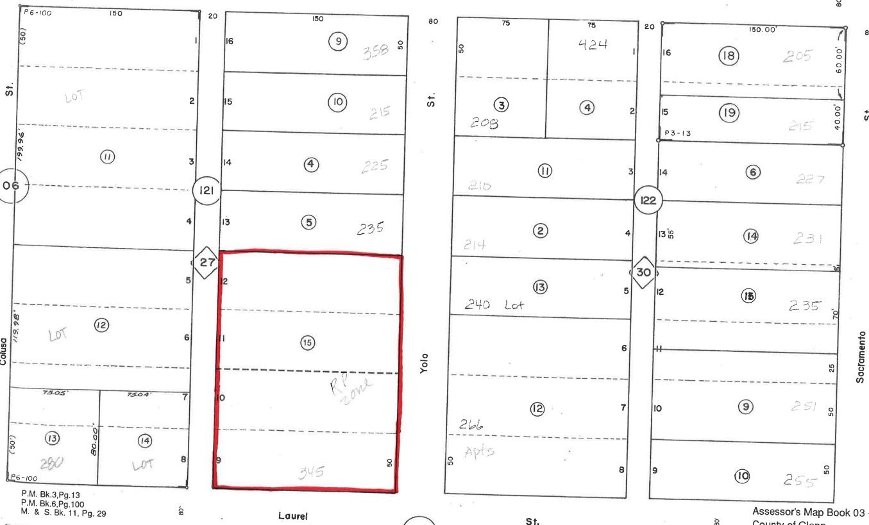
Assessor’s Parcel Map

Slide 8
Planning Commission Resolution
- Conducted Public Hearing
- Exempt from CEQA
- Consistent with the General Plan and Municipal Code
- Subject to Conditions of Approval

Slide 9
Location
345 Laurel St

